Slide 1
Container Terminals Business in Ukraine
Connecting countries and continents

Slide 2
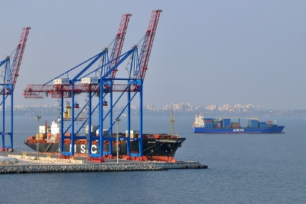
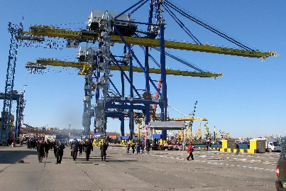
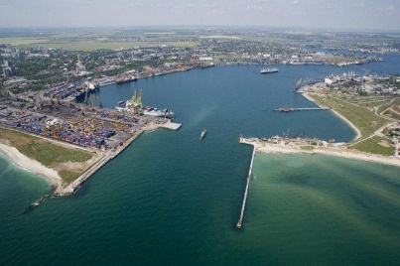
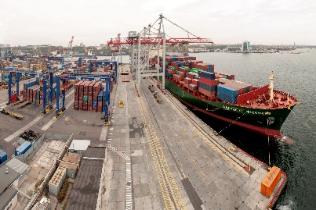
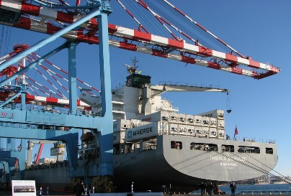
Container Terminals in Ukrainian Sea Ports
Brooklyn Kyiv Port
(Odessa Terminal LLC/ CMA CGM)
SE "Chornomorsk CSP“
(State enterprise)
Terminal area – 6 ha;
Berths 42,43: length - 480m, depth - 13,5m; outer channel - 14m;
Storage capacity - 5700 TEU;
Annual throughput capacity - 300 000 TEU,
4 RTGs "Konecranes“;
3 container handlers "ZPMC" Post-Panamax;
Reefer electrical outlets – 328.
Terminal area 29 ha;
Berths №№ 1-6, length from 155 - 320 m, depth - 15m, depth in the outer channel - 16m;
Annual throughput capacity - 1 mln TEU;
8 cranes Condor - 40/32/16 tons;
Capacity of the railway stations of the port - 1200 cars per day.
CMA CGM, COSCO, Evergreen Line
Chornomorsk Fish Port
(Espert Holding limited Cyprus)
Port area – 42 ha;
Berth № 2 max depth – 12.2 m
Berth № 4 – 437 m, depth – 14.5 m
Depth in the outer channel – 14.5 m
Depth in the inner channel – 14.0 m
Storage capacity – aprx. 10 000 TEU;
Rail track – 800 meters;
Reefer electrical outlets – 400.
MAERSK, MSC
TransInvestService LLC with
foreign investment
CTO (Hamburg Port and Logistic Corporation
HHLA AG, Germany)
Terminal area – 40 ha;
2 berths - 480 m, depth - 15m;
Annual throughput capacity 400 000 TEU;
Prospective throughput capacity - 2 mln. TEU;
Reefer electrical outlets – 308;
10 RTGs cranes;
3 STS cranes Super-Post- Panamax type of vessels;
Industrial park "I-Park“.
Terminal area - 14,5 ha;
Berths №№ 1K - 350m, 2K - 300,4m, 2 -310 m;
Storage capacity 13500 TEU;
Annual throughput capacity - 680 000 TEU;
7 STS Cranes "Liebher" for Post-Panamax type vessels;
11 RTGs "Konecrane" for rail, trucks and other equipment.
ZIM, ONE
MAERSK
2

Slide 3
Containers’ processing in the ports of Ukraine
Increasing the volume of container processing, thou TEU
(incl. Chornomorsk fish port)
Structure of container processing
for 8 mths. 2019, thou TEU
+ 35%
+ 19%
+ 18%
+ 19%
- 5%
8 mths.
172
+ 96%
+ 9%
8 mths.
211
8 mths.
78
8 mths.
66
7

Slide 4
Container Trains Operating in Ukraine
ZUBR: Latvia – Estonia
Viking: Lithuania – Belarus
1769 TEU
7981 TEU
Traffic volume for 9m 2018 TEU
Slovakia – Kazakhstan –
– Russia – China
Кyiv
Uzhgorod
1449 TEU
Kharkiv
2952 TEU
Khmelnitskiy
4782 TEU
1471 TEU
6376 TEU
Nizhnedneprovsk
Dnipro
9866 TEU
Chornomorsk
Yzhnuy
Odessa
Crimea
Black Sea TEU
Source: cfts.org.ua, liski.ua
4

Slide 5
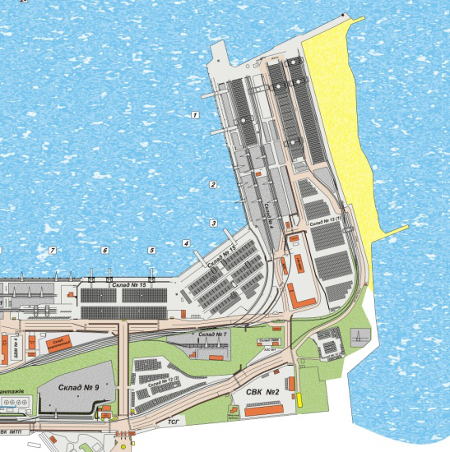
Development capacities of a state container terminal on berths No. 3,4,5,6 in Chornomorsk Sea Port
Operator – State Stevedore Company Chornomorsk;
Total area of the terminal - 29 hectares;
Length of berth line No. 3,4 - 320 m, depth - 13.6 m;
Length of berth line No. 5,6 - 335 m, depth - 11.1 m);
Annual throughput capacity - 650.0 thousand TEU;
It is proposed to increase the capacity of the container terminal by modernizing the mooring front and updating the handling equipment at berths No. 5,6: installation of 3 container cranes.
After reconstruction, annual throughput capacity – 1 mln. TEU
Potential depths – 15.0 m (port basin is on reconstruction)
Potential forms of private participation: lease, PPP.
1
2
3
6
5
4
5

Slide 6
THANKS FOR YOUR ATTENTION!
Official website
http://uspa.gov.ua
http://investinports.com
Investment Portal

